Slide 1
USABILITY TESTING AND VERIFICATION HUSSLE (fitness website)
Onkar
Dehane
11013736

Slide 2





INTRODUCTION
1

Slide 3
Introduction to Topics
2
SO I HAVE COME UP WITH A FITNESS WEBSITE NAME HUSSLE WHICH HELPS YOU TO GET YOUR BMI((BODY MASS INDEX)
ALSO SHOULD BE MAKING YOU AWARE OF THE WORKOUT HOW TO DO IT.WHAT ARE THE PROPER WAYS TO DO IT BY WATCHING VIDEOS
SEARCH FOR THE NEARBY GYMS IN YOUR CITY

Slide 4
Introduction to the use cases
3
user should look for the gym near them
They can calculate the BMI ( body mass index)
Should be able to see the fitness exercise video
User Should be able to take a membership to the gym
They can get a personal trainer
They can also buy the gym equipment
Also they can order a supplement/ Protein
Look for weight loss exercise or weight gain exercise
They can count the calories of food according to breakfast lunch and dinner

Slide 5
Motivation
4
Nowadays everyone is not aware of the health so I come up with some idea where to start and how to do it.
For where to start I am making them aware of that health by calculating their BMI (body mass index). Based on height and weight it will calculate BMI and that BMI will tell you that user is underweight or overweight .
After coming to know about their health from BMI then this app can guide them as a personal guidance for beginners level intermediate level and professional
If you still want to start a workout routine so he can find gym in nearby areas

Slide 6
Competitor Website
5
Weight watchers website doesn’t have a find a gym nearby you so I am including THIS OPTION
Mens health having a really cool features of showing the latest news regarding health but they don’t have a proper section which will show the proper workout sessions so I have included that

Slide 7
DESIGNING OF THE PRODUCT
6

Slide 8
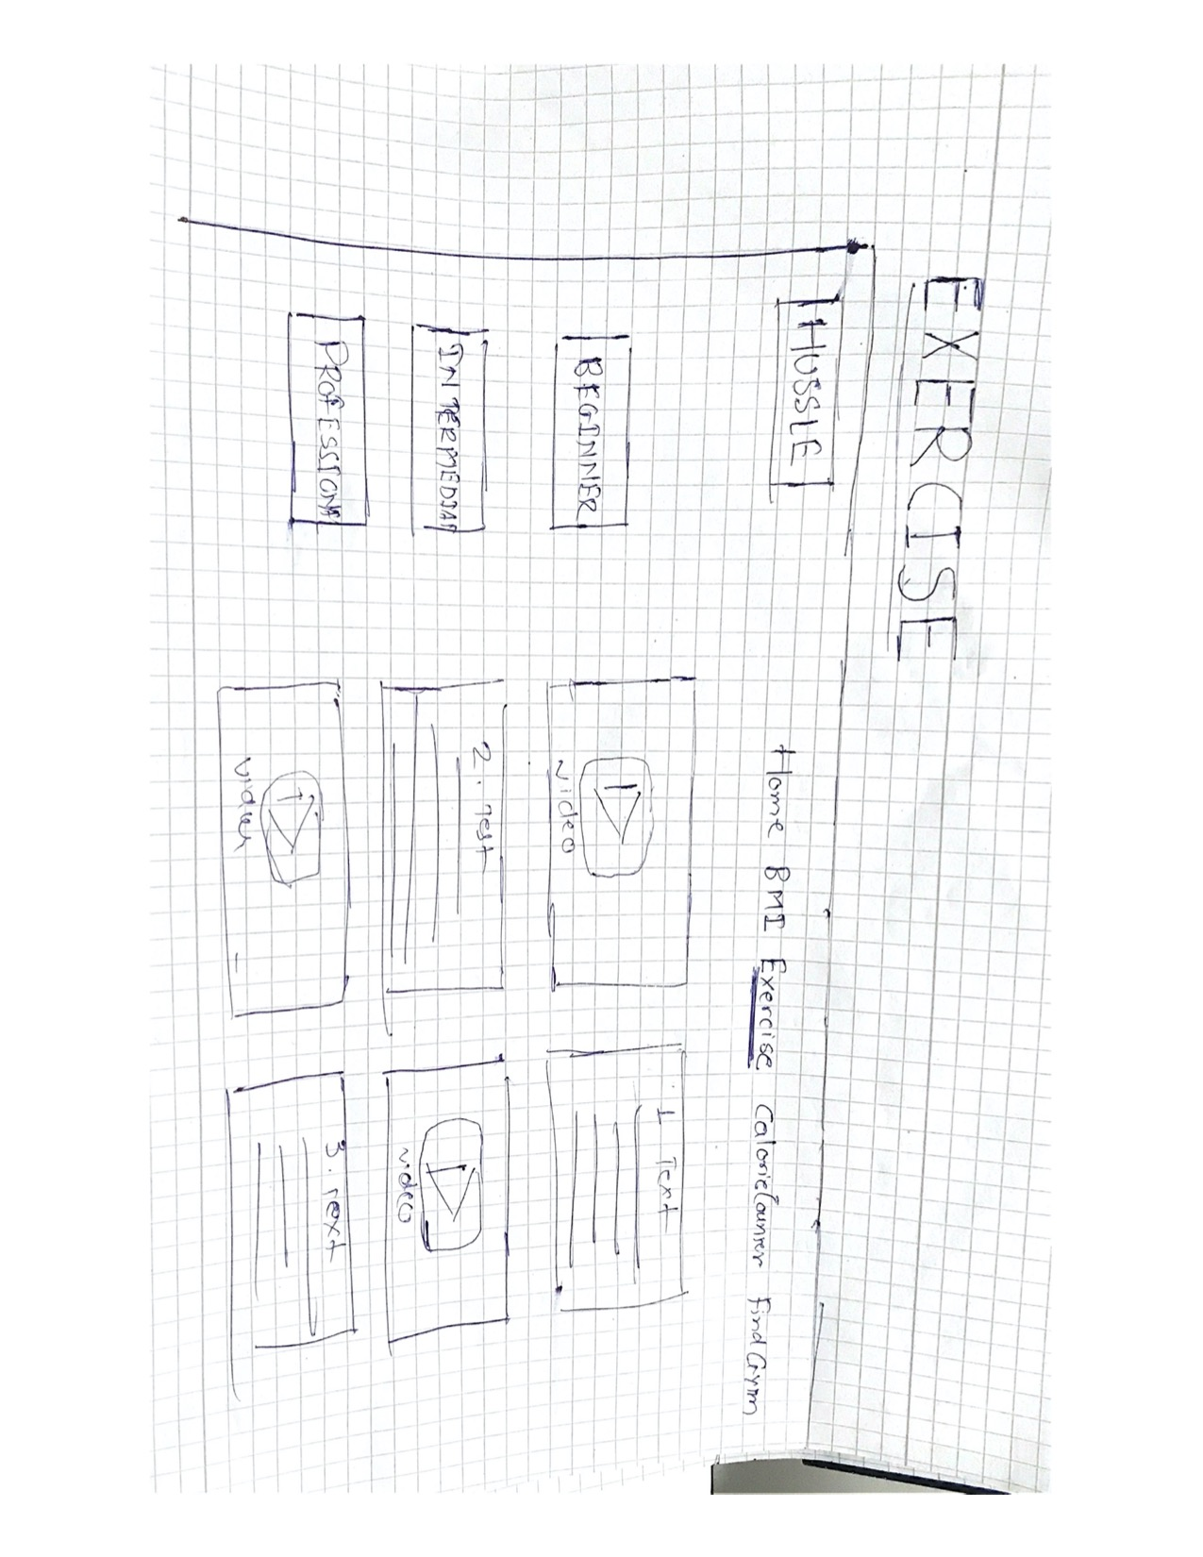
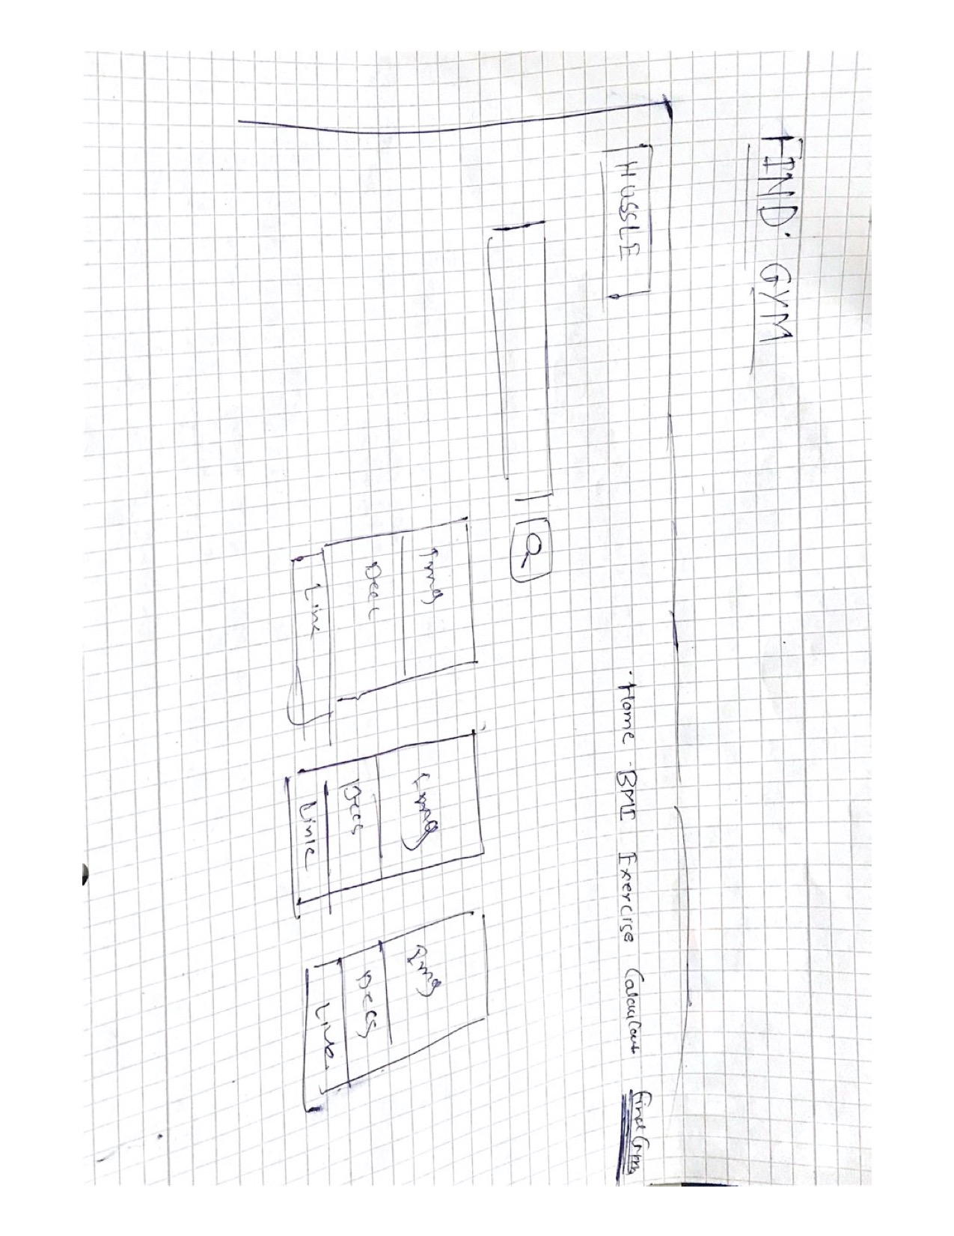
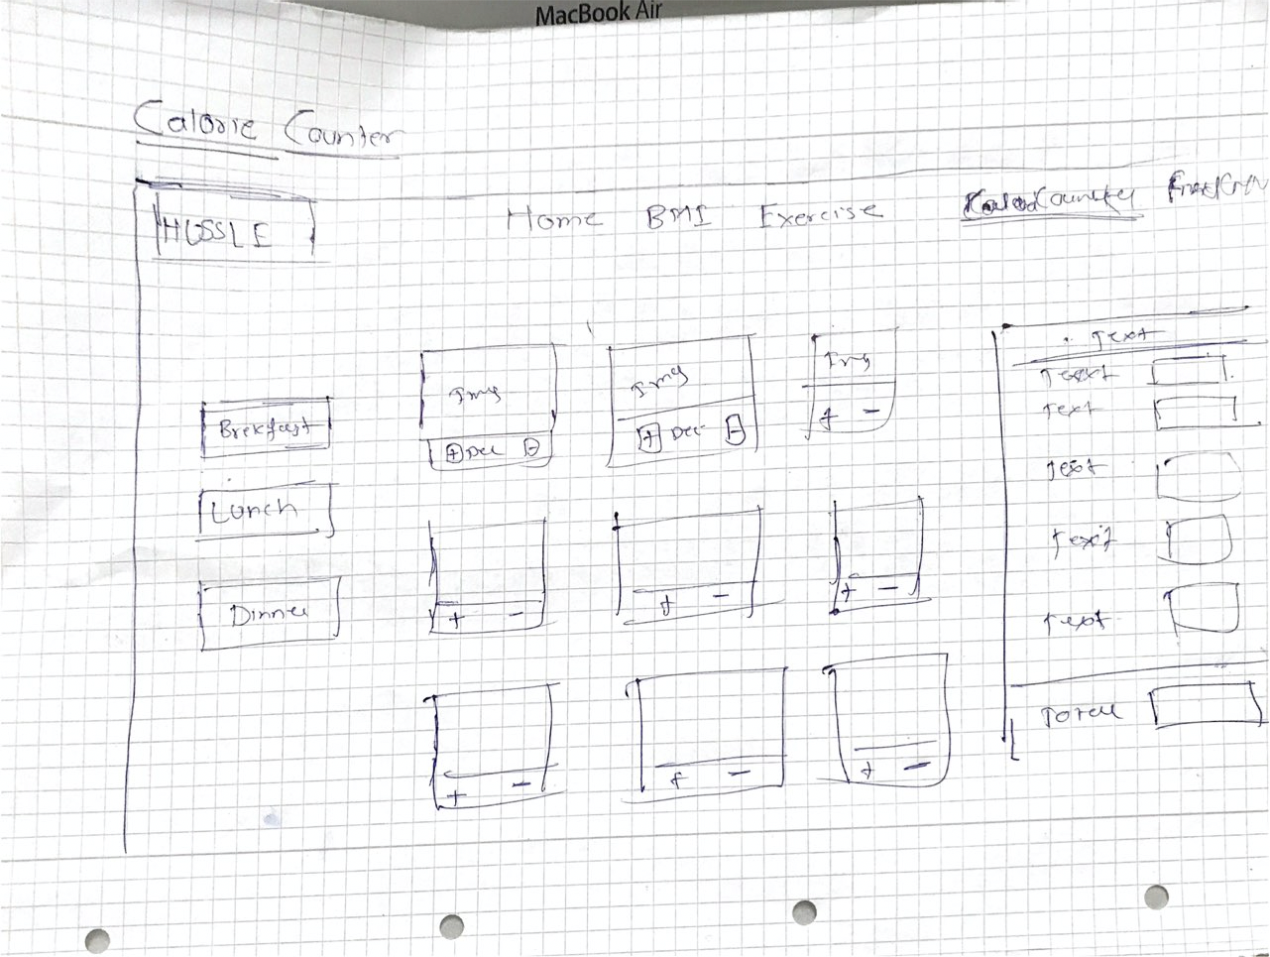
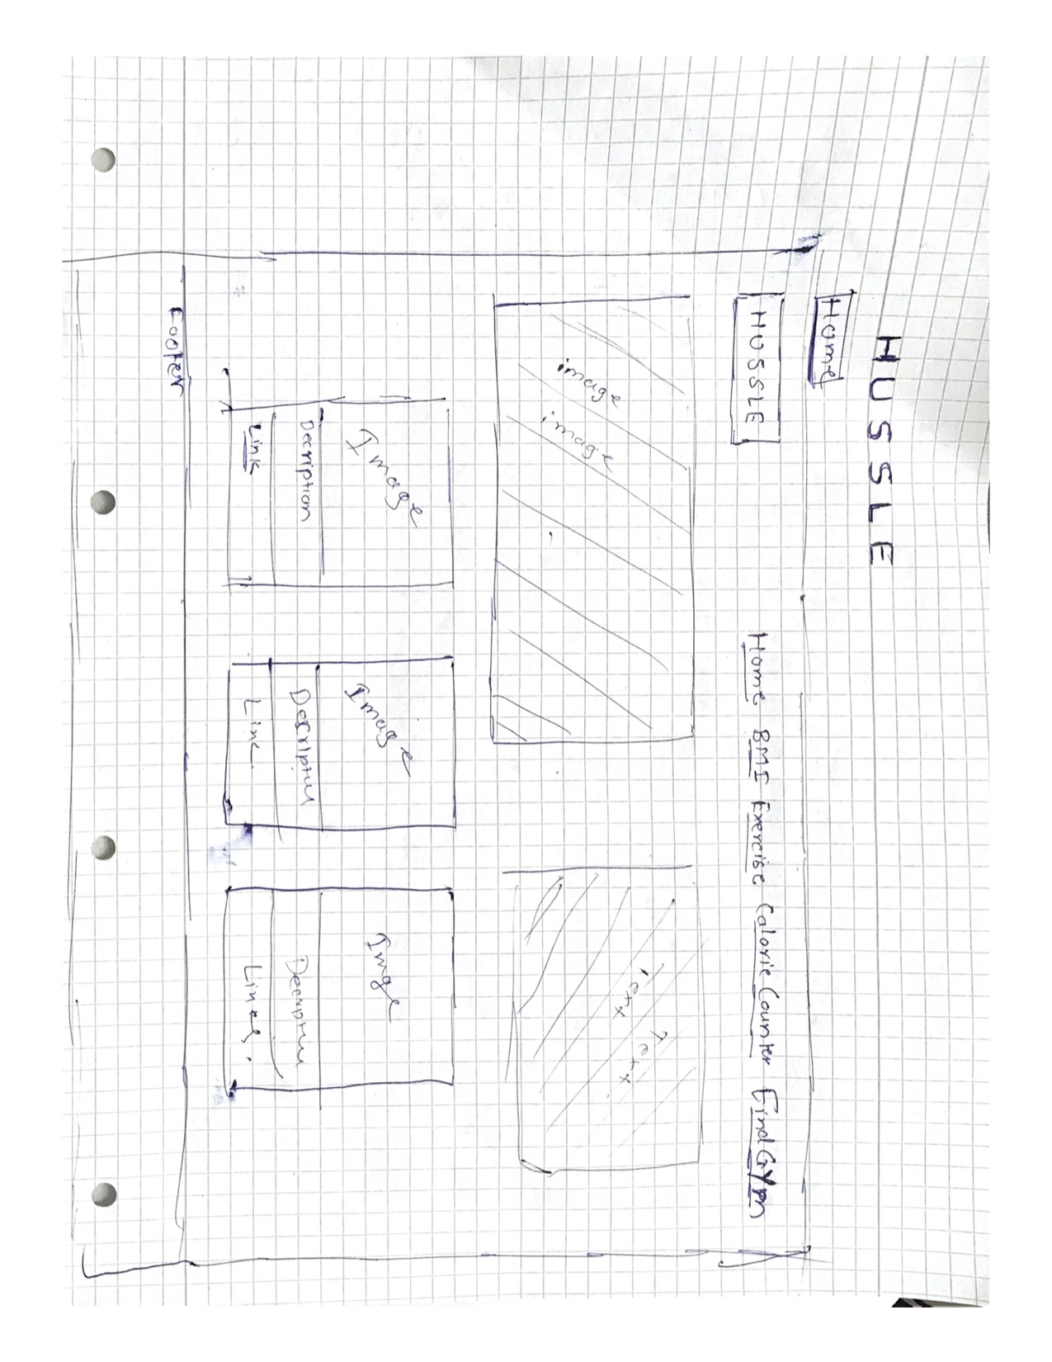
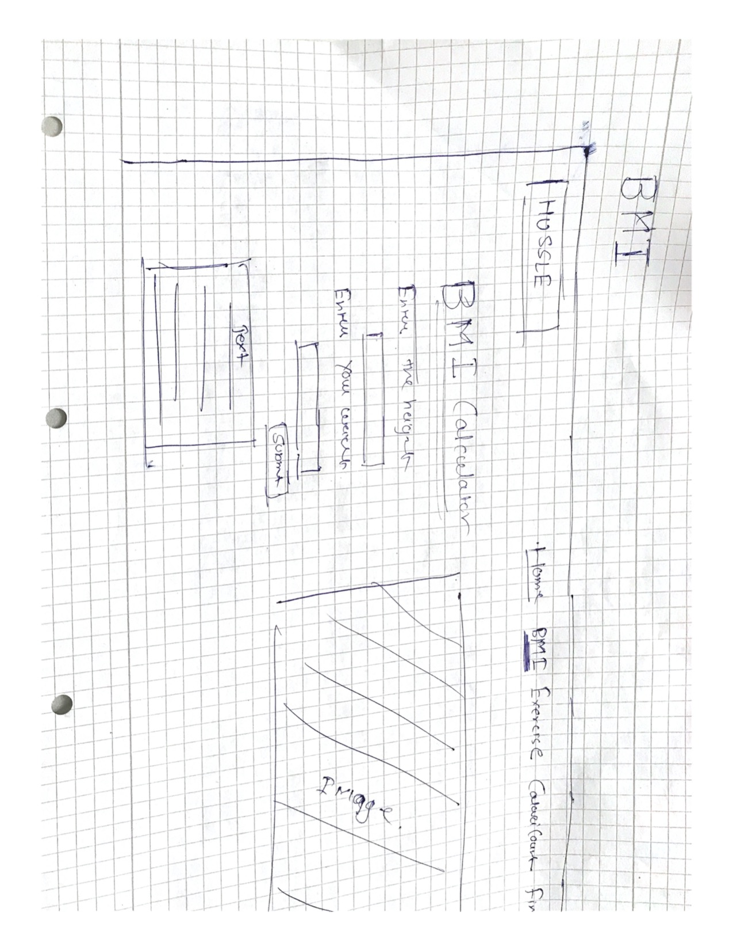
DESIGN PROCESS WIREFRAME
7

Slide 9
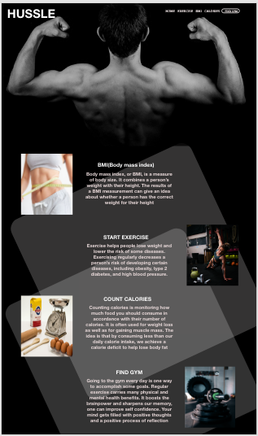
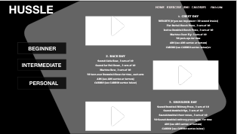
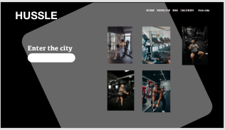
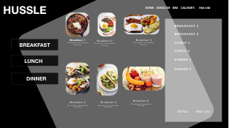
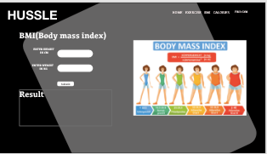
DESIGN PROCESS MOCKUP
8

Slide 10
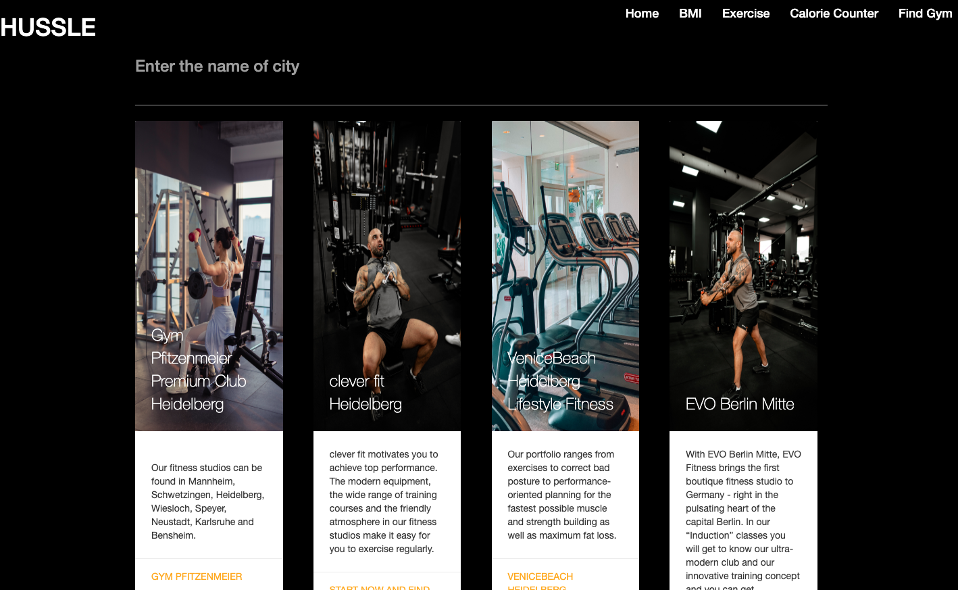
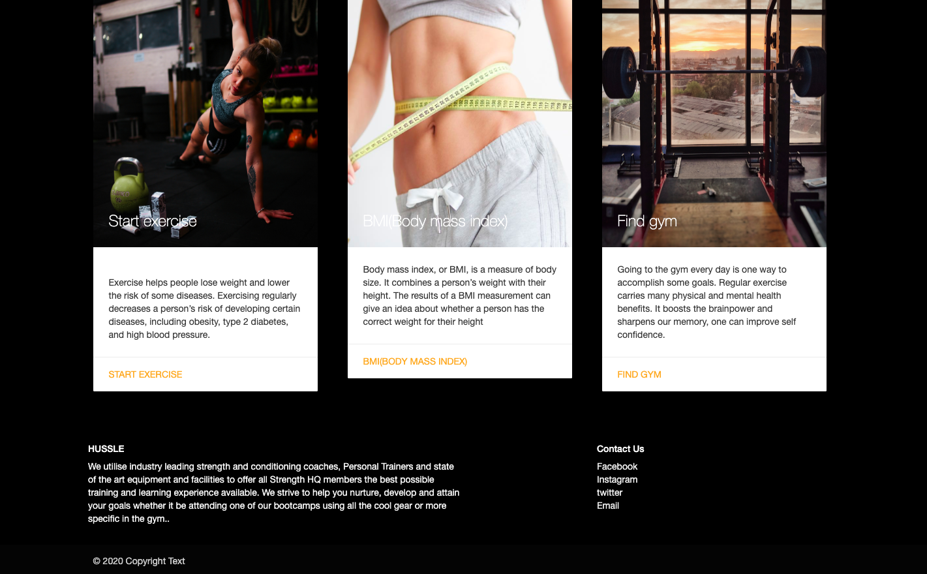
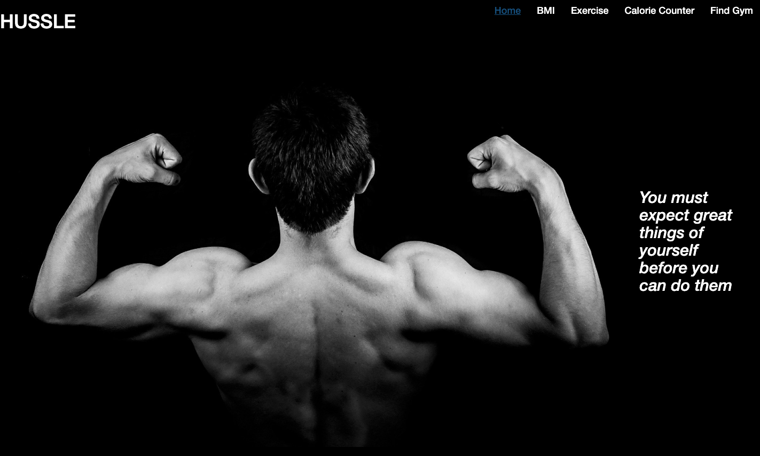
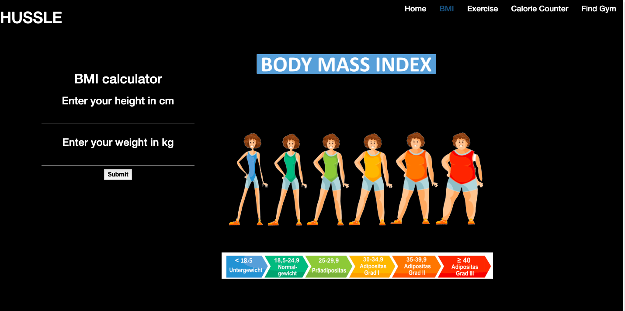
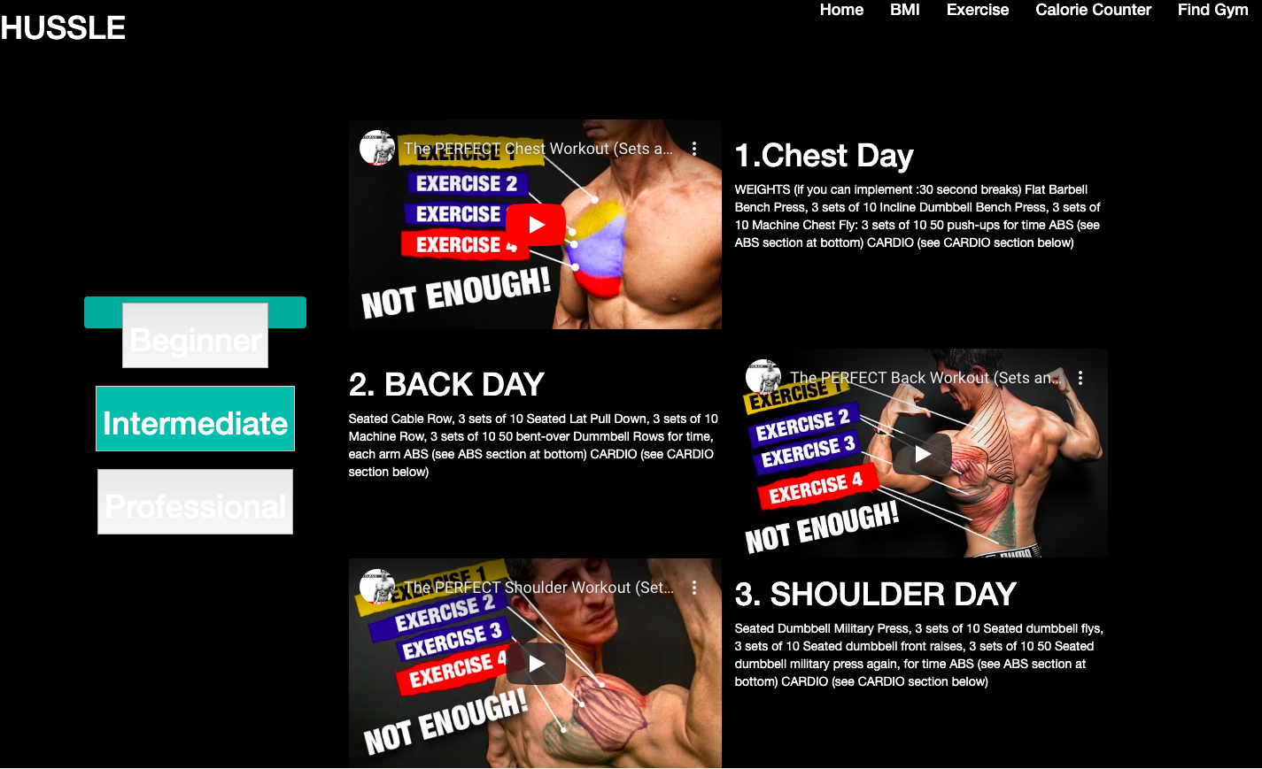
DESIGN PROCESS FINAL DESIGN
9

Slide 11

USABILITY TESTING

Slide 12
CONDUCT A SURVEY
10
Conducted a survey
Survey link: https://de.surveymonkey.com/results/SM-2L6TCPQT7/
Red roots
All of the time | look for Personal trainer | look for Nearest gym | BMI ( Body-Mass-Index) | Look for fitness exercise
Most of the time |  | Search for supplements | How to perform specific exercises | Count calories for Food intake
Some of the time |  | Look for weight loss exercises | Look for motivation exercises | take a membership of the gym
Very little of the time | Like to buy a gym Equipment |  |  | Order supplements online
 | Few of the people | Some of the people | Most of the people | All of the people

Slide 13
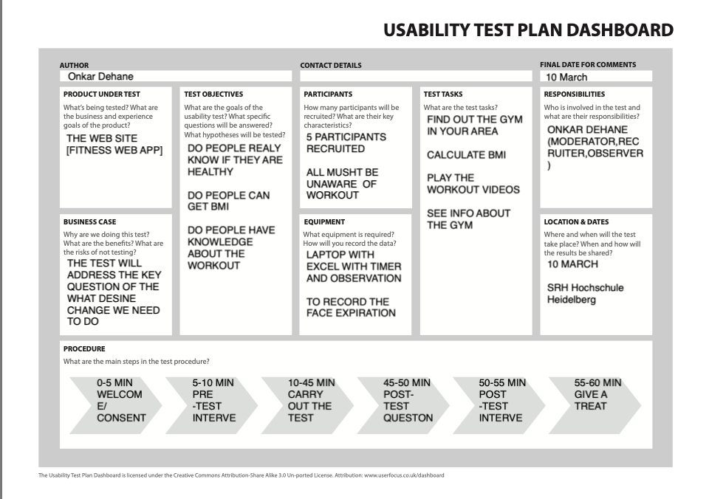
11
The Usability
Test Plan
Dashboard

Slide 14
USABILITY TESTING THINK ALOUD
12
Think-aloud protocols involve participants thinking aloud as they are performing a set of specified tasks. Participants are asked to say whatever comes into their mind as they complete the task. This might include what they are looking at, thinking, doing, and feeling
This gives observers insight into the participant's cognitive processes (rather than only their final product), to make thought processes as explicit as possible during task performance.
observers are asked to take notes of what participants say and do, without attempting to interpret their actions and words, and especially noting places where they encounter difficulty.

Slide 15
Analysis 1. Task Performance
13

Slide 16
Analysis 3.Task Completion(Adjusted) 4. Task Completion and Confidence(Non-Adjusted)

Slide 17
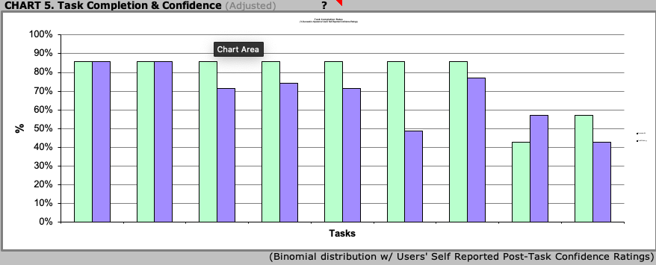
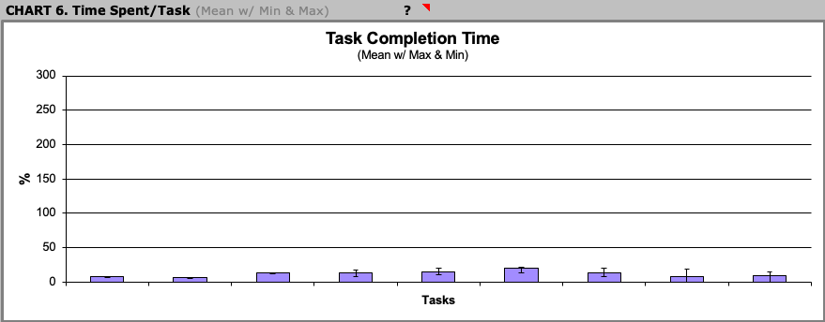
Analysis Task Completion and Confidence(Adjusted) Time Spent/Task
14

Slide 18
Analysis Efficiency
15
USER | TASK TIME
 |  | TASK 1 | TASK 2 | TASK 3 | TASK 4 | TASK 5 | TASK 6 | TASK 7 | TASK 8 | TASK 9
 | USER 1 | 8 | 7 | 14 | 18 | 15 | 22 | 20 | 19 | 11
 | USER 2 | 8 | 7 | 14 | 18 | 15 | 22 | 20 | 19 | 15
 | USER 3 | 9 | 6 | 12 | 8 | 21 | 14 | 8 | 19 | 14
 | USER 4 | 6 | 6 | 14 | 8 | 11 | 21 | 8 | 11 | 15
 | USER 5 | 6 | 6 | 14 | 18 | 15 | 22 | 15 | 19 | 15
 | Avg | 8 | 6 | 14 | 14 | 15 | 20 | 14 | 17 | 14
 | STD . Deviation | 1.2 | 0.489897949 | 0.8 | 4.89897949 | 3.2 | 3.12409987 | 5.38144962 | 3.2 | 1.54919334
 | HIGH | 10 | 7 | 16 | 23,408 | 21 | 26 | 25 | 23 | 17
 | LOW | 6 | 5 | 12 | 5 | 9 | 14 | 3 | 11 | 11

Slide 19
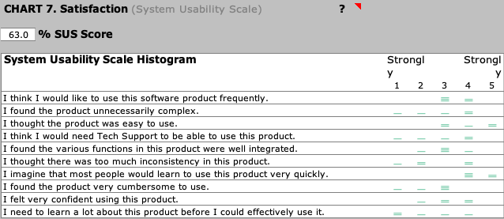
Satisfaction
16

Slide 20
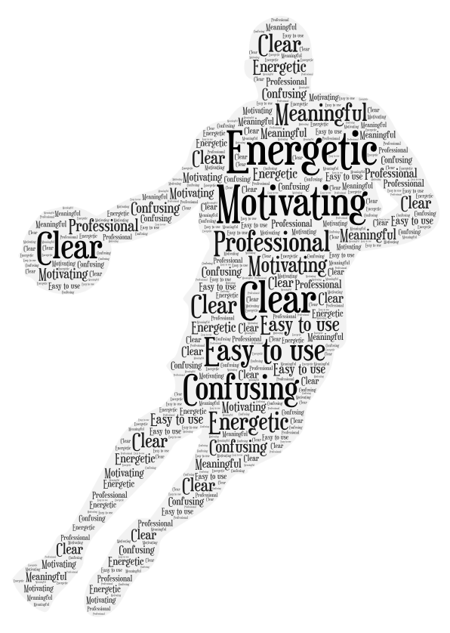
WORD ART
17

Slide 21
Lesson learned
18
HOW TO CONDUCT A SURVEY
HOW TO DO USABILITY TESTING WITH USERS IN REAL TIME
HOW TO DEVELOP A TEST TASK
HOW TO CHOOSE THE RIGHT USABILITY TEST METHOD FOR PRODUCT
HOW TO DEVELOP A WEBSITE USING REACT JS
ALSO LEARNED AUTOMATIC TESTING

Slide 22

Q&A

